Slide 1
Income and Liquor Spending Behavior Across Iowa Counties
A Data Driven Policy Analysis (2012 – 2016)
Group 2: Shreyansh Budhia, William Brewster, Ramzi Nia

Slide 2
Project Rationale
Liquor spending varies across Iowa counties.
Policymakers and distributors need county level insights
Key questions:
  Do geographies with higher median income consume more alcohol in total and in per capita?
  Which counties show unusually high consumption?
  Are liquor purchasing patterns similar across the state?
  The study tries answering:
  “Does income influence liquor spending behavior across Iowa counties?”

Slide 3
Data Sources
Two major datasets were integrated:
Iowa Liquor Sales Dataset(2020)
  This dataset contained 990 county category observations
  It included total dollar sales, volumes, and product categories
  It identified consumption at the county level
ACS Demographic Dataset(2019)
  This dataset contained demographic information for the above mentioned 99 Iowa counties
  It contained median household income and total population
  It was used to create per-capita consumption measures

Slide 4
Data Sources (Contd.)
These datasets were merged together to include:
  Total sales by county
  Dollars per capita
  Category level spending percentages
  County demographics

Slide 5
Per Capita Spending Transformation
Total sales data was transformed into per capita information to:
  Control for county size
  Reveal true household based consumption intensity
  Allow meaningful comparison across all 99 counties
This was computed as:
  Per Capita Sending = Total Sales ($)/Population

Slide 6
Descriptive Statistics: Income, Sales, and Population
Variable | Mean | Median | Minimum | Maximum
Median Household Income ($) | 29,981.98 | 30,253.50 | 18,959.00 | 43,120.00
Population | 31,556.47 | 15,606.50 | 3,822.00 | 459,159.00
Total Liquor Sales ($) | 2,680,881.68 | 782,309.50 | 25,053.00 | 61,059,636.00
Liquor Dollars Per Capita ($) | 58.50 | 55.61 | 3.57 | 220.83

Slide 7
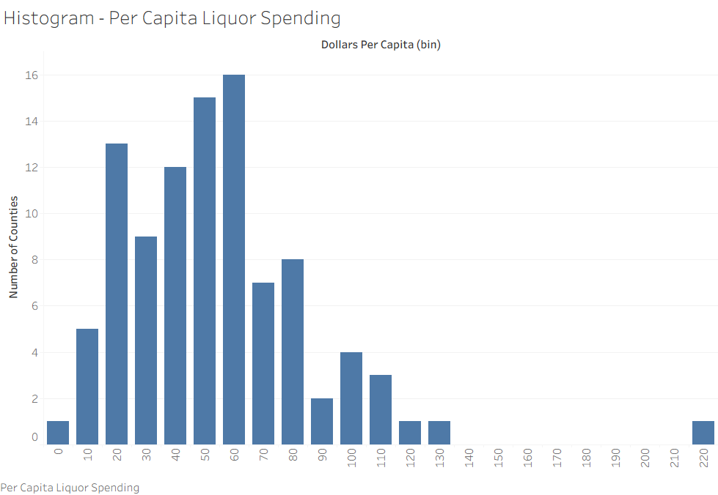
Distribution of Per Capita Spending
The distribution is highly right skewed:
Most counties fall between $30-$80 per person per year
Several counties exceed $120
One county surpasses $220
A small group of counties exhibits significant higher consumption, disproportionately influencing statewide averages

Slide 8
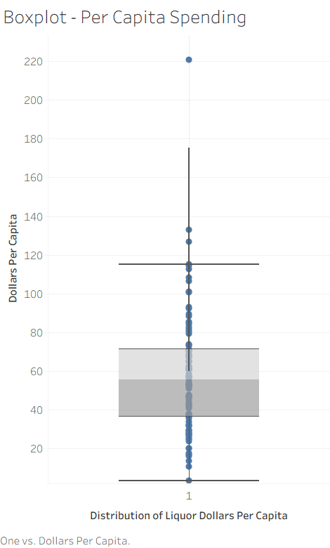
Distribution of Per Capita Spending (Contd.)
The boxplot visually reinforces:
A wide interquartile range, indicating genuine variation
Several upper tail outliers, showing very high spending counties
A moderate median around $55 per capita
Therefore, liquor spending intensity does not seem to be uniform

Slide 9
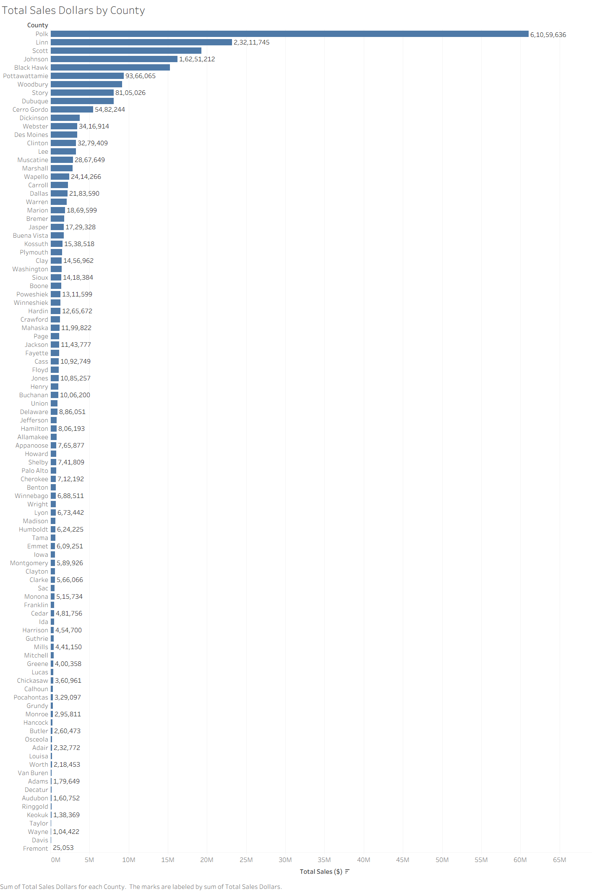
Total Sales by County
Large urban counties seem to dominate sales:
Polk, Linn, Johnson seem to have the highest total liquor sales
This pattern mirrors population distribution in the region
Higher sales does not necessarily imply higher individual consumption
Comparative graphs in the next slide showcase highest total liquor sales counties versus highest per capita sales counties.

Slide 10
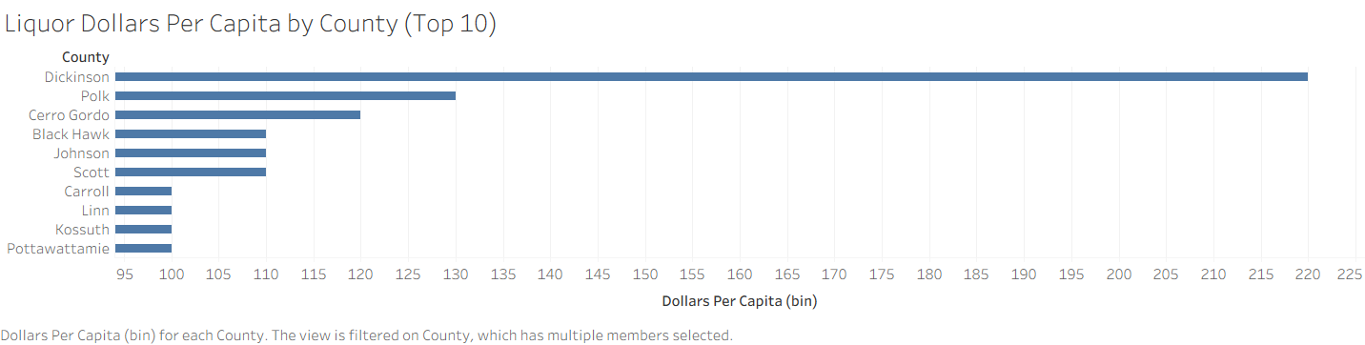
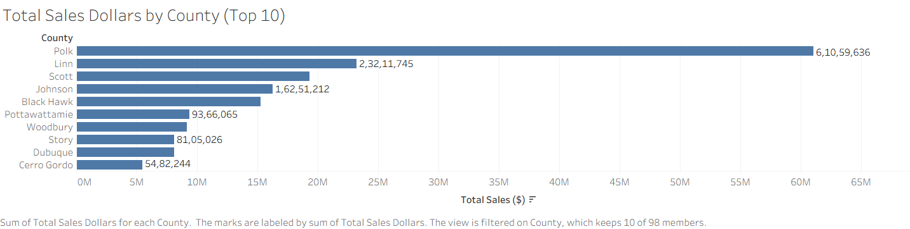

Slide 11
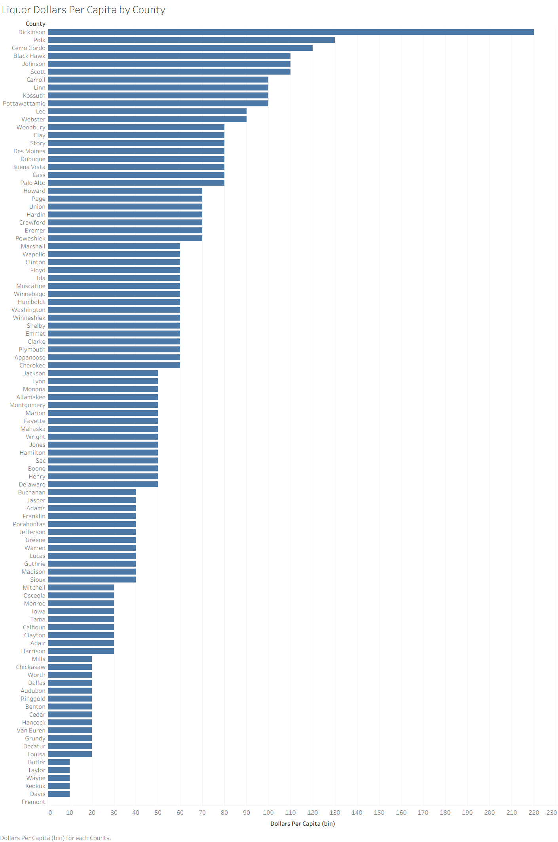
Total Sales by County
(Contd.)
As demonstrated in the graphs, counties with highest liquor sales and highest per capita liquor sales are not necessarily the same. Dickinson county, for example, ranks extremely high in per capita liquor spending despite not being a top sales county.

Slide 12
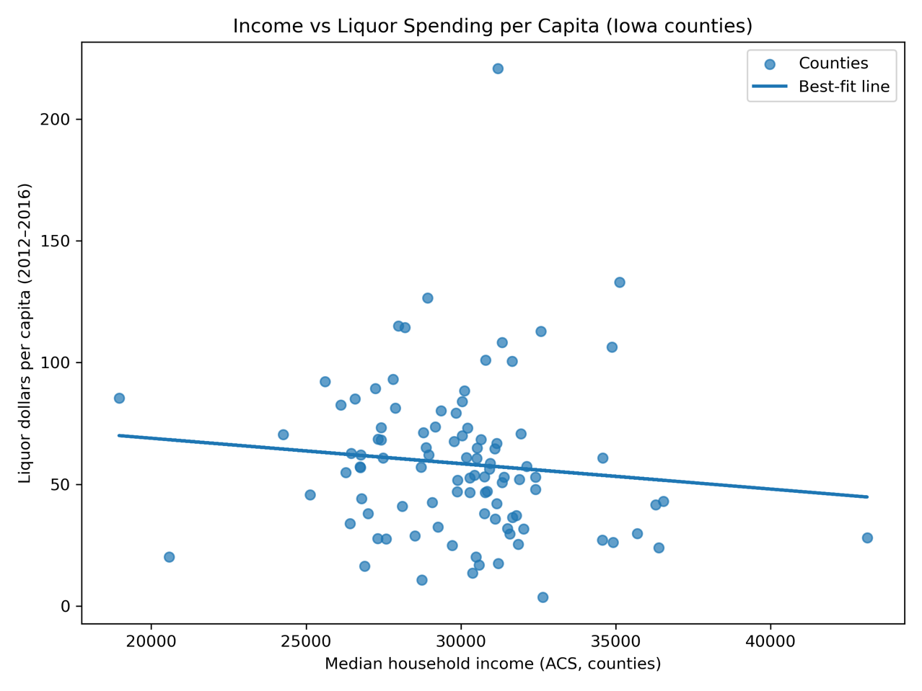
Income vs Liquor Spending Per Capita
Counterintuitive to the popular assumption, as demonstrated by the analysis – albeit with weaker degree of correlation ( r ≈ -0.106) – higher levels of income do not necessarily mean higher levels of per capita liquor consumption. Contrarily, the data seems to inconclusively suggest that higher income levels lead to lower per capita liquor consumption.

Slide 13
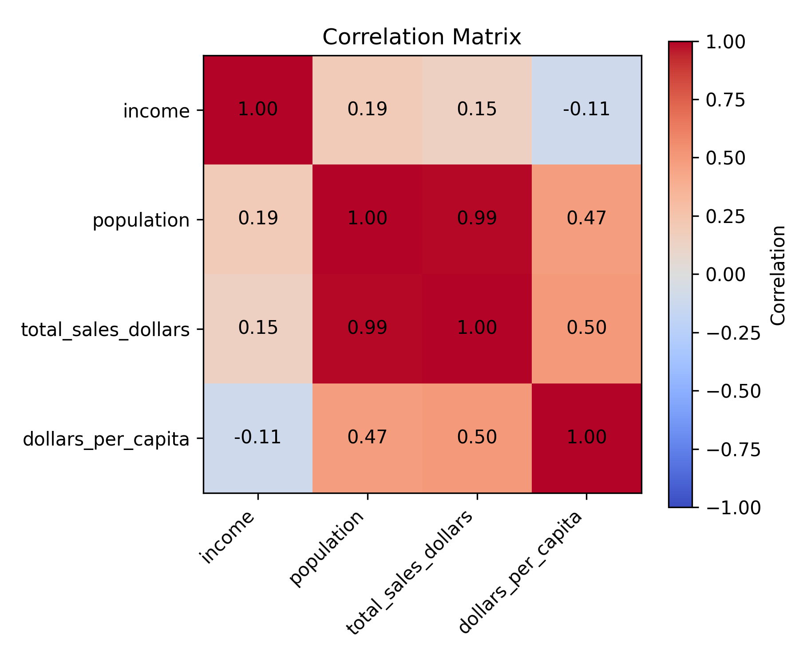
Correlation Matrix Findings
Income has a poor correlation coefficient with total sales and per capita liquor sales. It is not a good predictor of per capita liquor sales and total liquor sales.
Population is strongly correlated to total sales, but it is poorly correlated to per capita liquor sale.
Consumption patterns seem to stem from factors outside this dataset, might be those associated with greater population levels, and cannot be explained by income levels.

Slide 14
Summary of Analytical Insights
Per capita consumption varies widely despite similar incomes.
Income does not predict consumption behavior.
Liquor category preferences seem stable across counties.
Population explains total sales, but not individual liquor spending

Slide 15
Policy Implications
For State Policymakers
Uniform alcohol tax structure is appropriate — income does not shape consumption
Counties with high per-capita spending merit targeted public-health interventions
For Public Health Agencies
Focus on behavioral drivers in outlier counties, and not income levels.
Deploy education and prevention resources strategically
For Liquor Distributors
Plan distribution based on population, not income levels

